Slide 1

Project Title: Smart Contract for Land Registry
By - Shubham Rathore

Slide 2

PROBLEM STATEMENT
The traditional land registry system suffers from fraud, lack of transparency, inefficient record-keeping, and lengthy procedures. Centralized databases and paper-based documentation are vulnerable to tampering, disputes, and record loss, causing delays and financial losses. A blockchain-based Land Registry System ensures secure, transparent, and tamper-proof registration and ownership transfers. By automating verification and preventing forgery, it allows only rightful owners to transfer land, improving trust and efficiency.

Slide 3
Project Description:
The blockchain-powered Land Registry System ensures secure, transparent, and tamper-proof property management. Built on Ethereum, it registers land with unique IDs, prevents fraud, enables secure ownership transfers, and provides instant verification via the blockchain. By automating processes and eliminating intermediaries, it reduces delays, costs, and paperwork, enhancing trust and efficiency in land transactions.

Slide 4

WHO ARE THE END USERS?
Government Authorities – Land verification & regulation.
Property Owners – Register & manage ownership.
Buyers & Sellers – Secure transactions.
Legal Entities – Verify & process deals.
Banks & Lenders – Ownership validation.
Real Estate Agents – Transaction facilitation.
Developers – Legal land acquisition.

Slide 5

Technology Used
Blockchain: Ethereum
Smart Contracts: Solidity
Development Tools: Ganache, VS Code
Wallet: MetaMask
Framework: Truffle
Frontend: HTML/CSS/JS

Slide 6
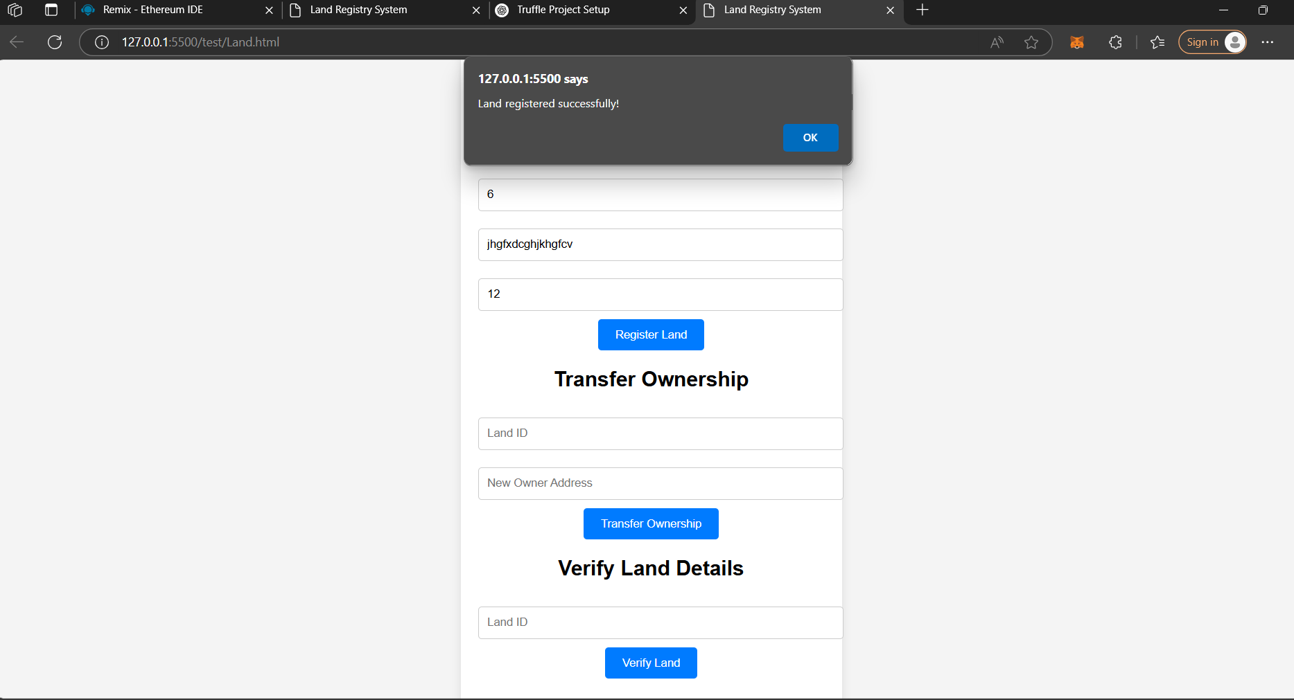
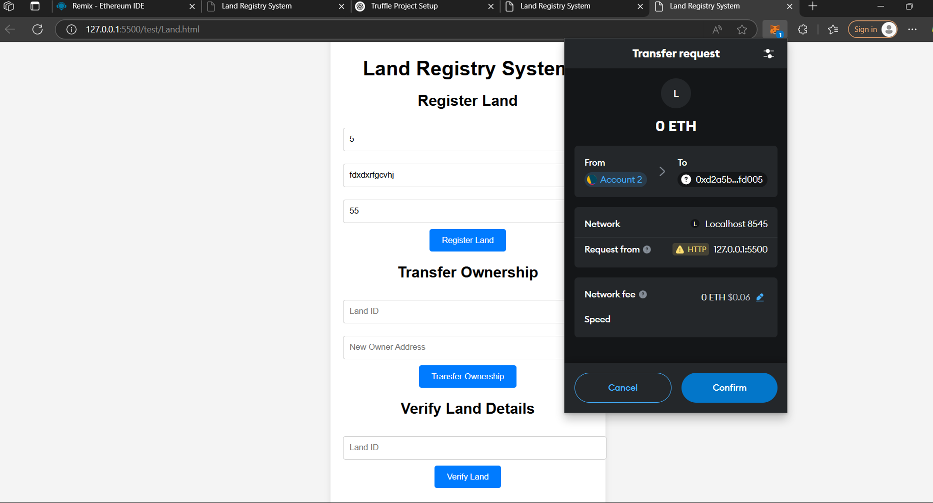
Results

Slide 7
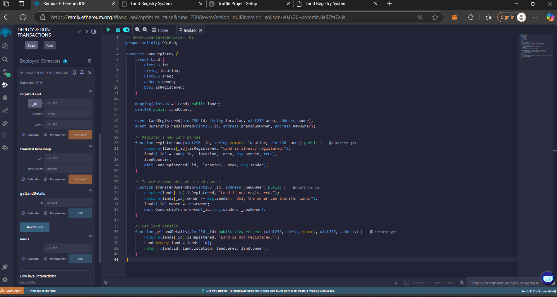
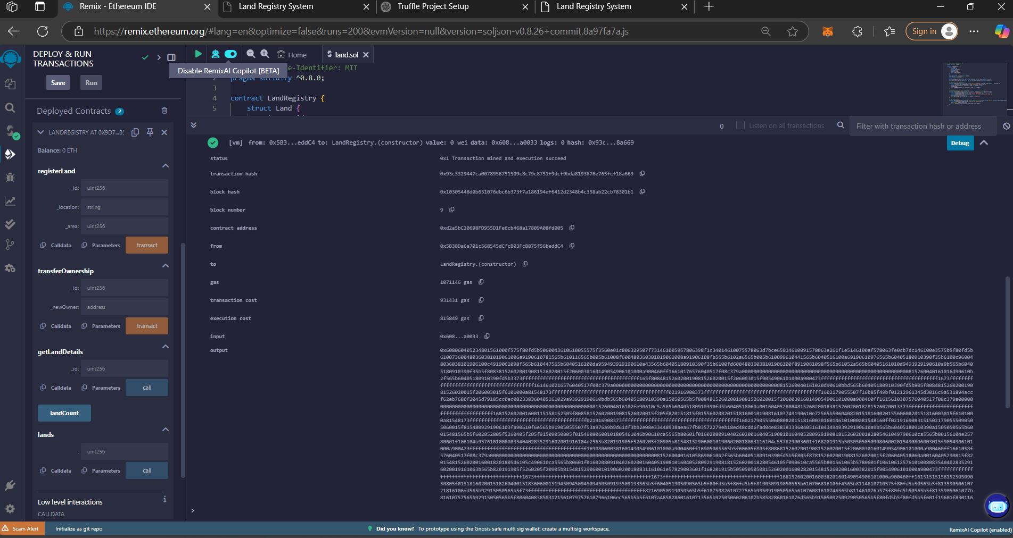
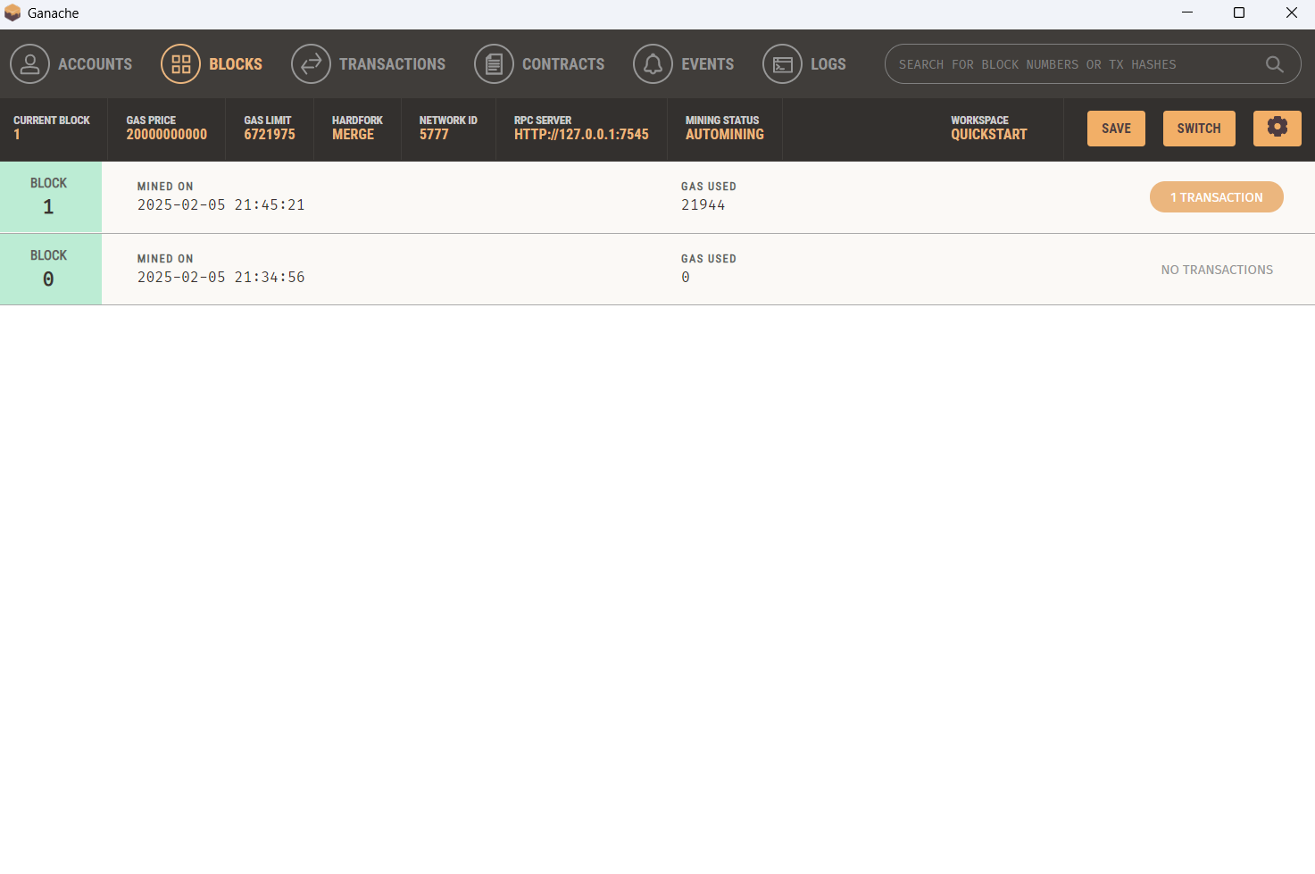
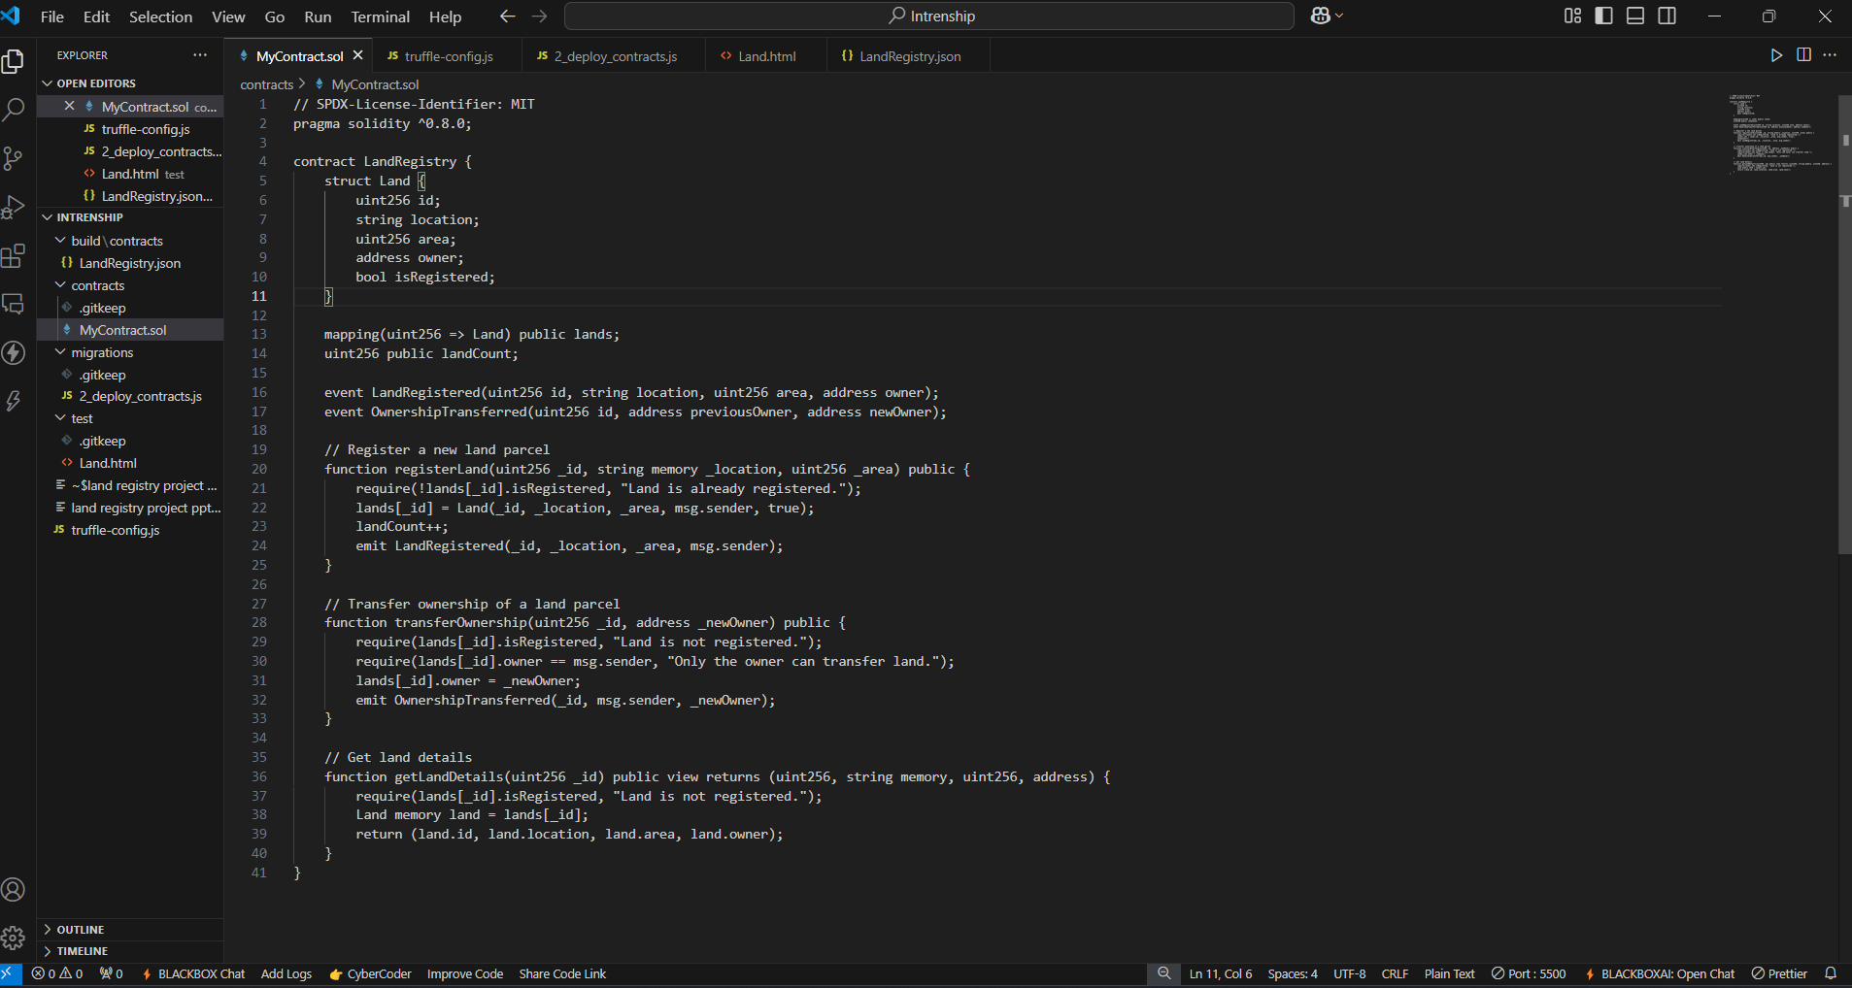

Slide 8
Thank you
.
.

